Slide 1
GRADE 7 ACCELERATED · UNIT 3 · LESSON 9
Writing Small Numbers in Scientific Notation
MA.8.NSO.1.4
I can write very small numbers in scientific notation, read them back, and find how many times larger or smaller one number is than another.
Grade 7 Accelerated · Unit 3 · Lesson 9 — Writing Small Numbers in Scientific Notation
1

Slide 2

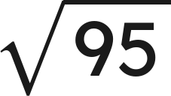
Warm-Up
1. Write 4,300,000 in scientific notation.
2. Write
as a fraction.
3.
is between which two whole numbers?
4. Write 0.007 as a fraction.
Grade 7 Accelerated · Unit 3 · Lesson 9 — Writing Small Numbers in Scientific Notation
2

Slide 3
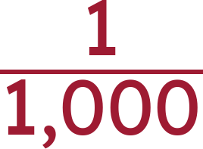
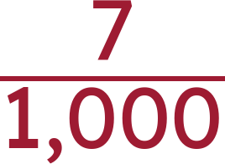
Warm-Up
1. Write 4,300,000 in scientific notation.
4.3 × 10⁶
2. Write
as a fraction.
3.
is between which two whole numbers?
9 and 10
4. Write 0.007 as a fraction.
Grade 7 Accelerated · Unit 3 · Lesson 9 — Writing Small Numbers in Scientific Notation
3

Slide 4
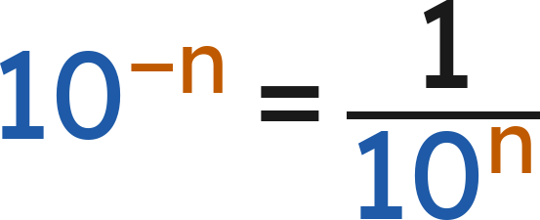
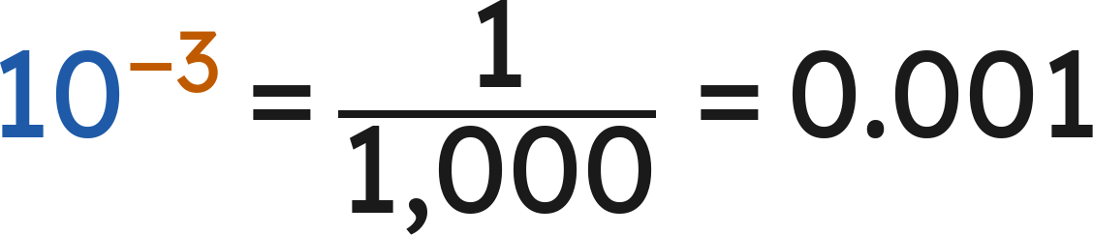
Notes
I. Negative powers of ten name the decimal places
10⁰ | 10⁻¹ | 10⁻² | 10⁻³ | 10⁻⁴ | 10⁻⁵
1 | 0.1 | 0.01 | 0.001 | 0.0001 | 0.00001
A negative exponent puts the 1 in that decimal place: 10⁻⁴ is a 1 in the fourth place.
Grade 7 Accelerated · Unit 3 · Lesson 9 — Writing Small Numbers in Scientific Notation
4

Slide 5
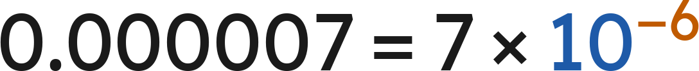
Notes
II. Small numbers in scientific notation
The coefficient is still at least 1 and less than 10. The exponent is negative for a number less than 1.
The exponent is how many places the point moves: from 0.0000672 to 6.72 is five places right, so 10⁻⁵.
Grade 7 Accelerated · Unit 3 · Lesson 9 — Writing Small Numbers in Scientific Notation
5

Slide 6
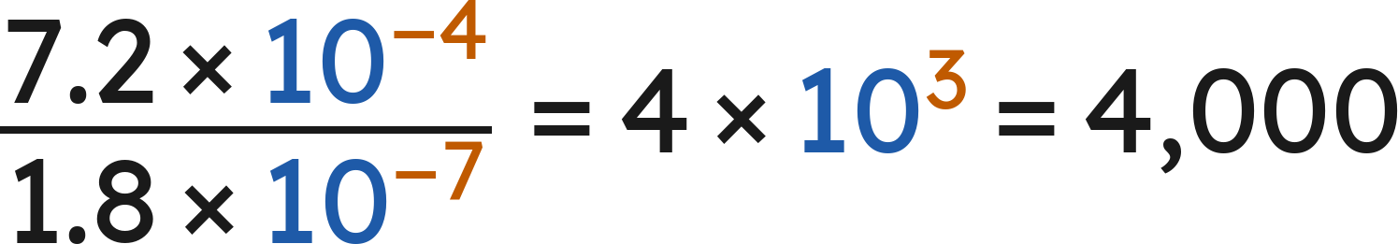
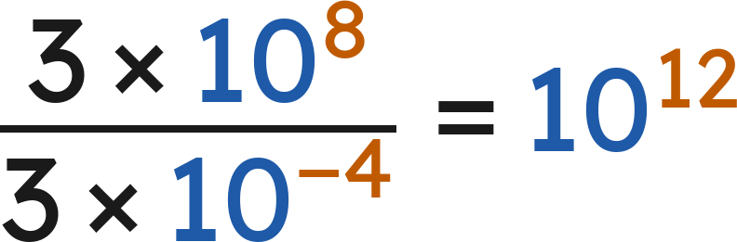
Notes
III. How many times larger — or smaller?
Divide the coefficients. Divide the powers of 10 — subtract the exponents. Multiply the results.
Which is bigger, 10⁻⁵ or 10⁻⁸? The one with the larger exponent: −5 > −8, so 10⁻⁵.
Grade 7 Accelerated · Unit 3 · Lesson 9 — Writing Small Numbers in Scientific Notation
6

Slide 7
Example 1
The density of oxygen is 1,332 millionths of a gram per cubic centimeter.
Write this value as a decimal, then in scientific notation.
Grade 7 Accelerated · Unit 3 · Lesson 9 — Writing Small Numbers in Scientific Notation
7

Slide 8
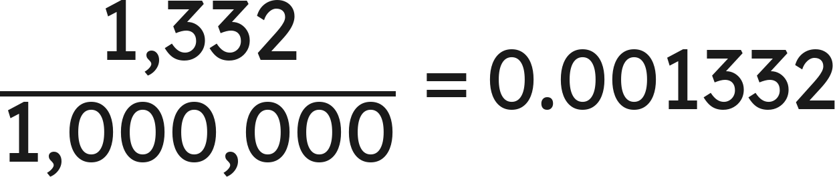
Example 1
Answer: 0.001332 = 1.332 × 10⁻³
Grade 7 Accelerated · Unit 3 · Lesson 9 — Writing Small Numbers in Scientific Notation
8

Slide 9
Your Turn
A human hair is about 67 hundred-thousandths of an inch thick.
Write this value in scientific notation.
Grade 7 Accelerated · Unit 3 · Lesson 9 — Writing Small Numbers in Scientific Notation
9

Slide 10
Your Turn
A human hair is about 67 hundred-thousandths of an inch thick.
Write this value in scientific notation.
67 hundred-thousandths = 0.00067
Move the point 4 places right: 6.7
Answer: 6.7 × 10⁻⁴
Grade 7 Accelerated · Unit 3 · Lesson 9 — Writing Small Numbers in Scientific Notation
10

Slide 11
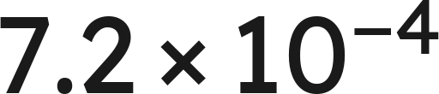
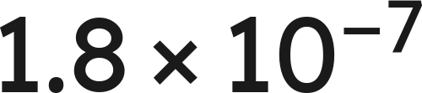
Example 2
How many times larger is
than
?
Grade 7 Accelerated · Unit 3 · Lesson 9 — Writing Small Numbers in Scientific Notation
11

Slide 12
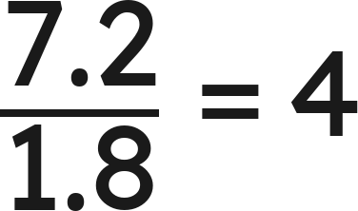
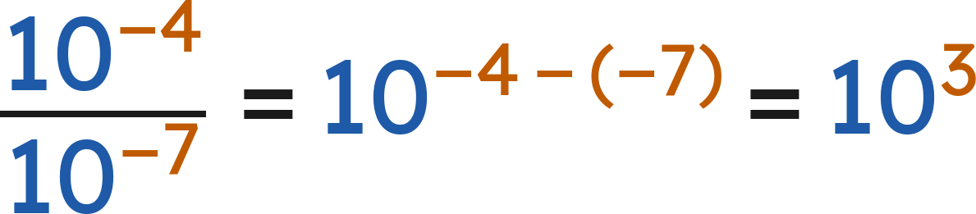
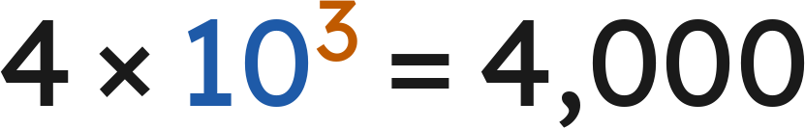
Example 2
Answer: 4,000 times larger
Grade 7 Accelerated · Unit 3 · Lesson 9 — Writing Small Numbers in Scientific Notation
12

Slide 13
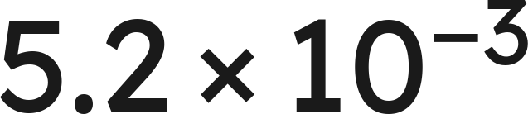
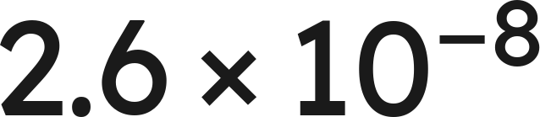
Your Turn
How many times larger is
than
?
Grade 7 Accelerated · Unit 3 · Lesson 9 — Writing Small Numbers in Scientific Notation
13

Slide 14
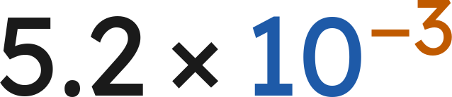
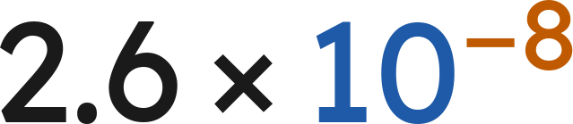

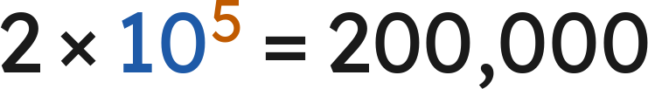
Your Turn
How many times larger is
than
?
Divide the numbers:
Divide the powers:
Answer: 200,000 times larger
Grade 7 Accelerated · Unit 3 · Lesson 9 — Writing Small Numbers in Scientific Notation
14

Slide 15
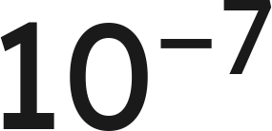
Whiteboards · Question 1 of 9
Answer it.
Grade 7 Accelerated · Unit 3 · Lesson 9 — Writing Small Numbers in Scientific Notation
15

Slide 16

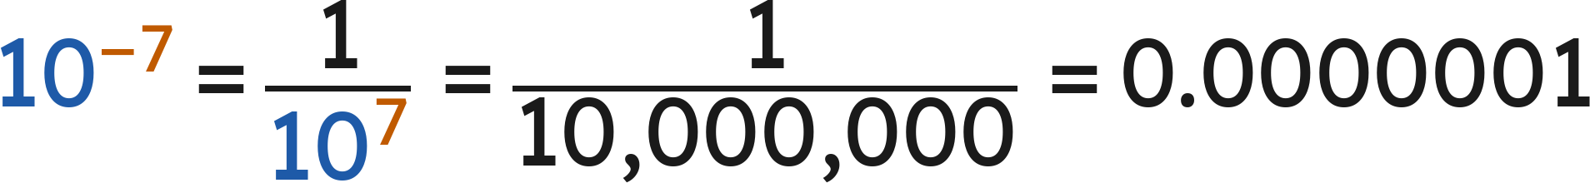
Whiteboards · Question 1 of 9
Answer: 0.0000001
Grade 7 Accelerated · Unit 3 · Lesson 9 — Writing Small Numbers in Scientific Notation
16

Slide 17
Whiteboards · Question 2 of 9
Write 0.003 in scientific notation.
Answer it.
Grade 7 Accelerated · Unit 3 · Lesson 9 — Writing Small Numbers in Scientific Notation
17

Slide 18
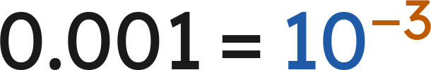
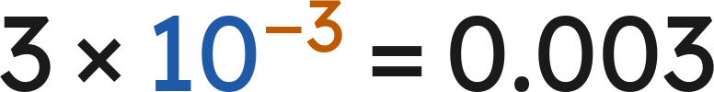
Whiteboards · Question 2 of 9
Write 0.003 in scientific notation.
The 3 is in the thousandths place:
Answer: 3 × 10⁻³
Grade 7 Accelerated · Unit 3 · Lesson 9 — Writing Small Numbers in Scientific Notation
18

Slide 19
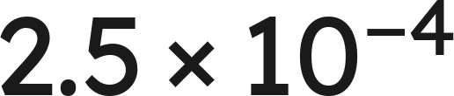
Whiteboards · Question 3 of 9
Write
in standard form.
Answer it.
Grade 7 Accelerated · Unit 3 · Lesson 9 — Writing Small Numbers in Scientific Notation
19

Slide 20
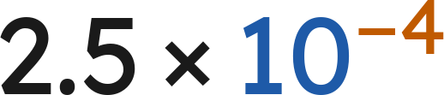

Whiteboards · Question 3 of 9
Write
in standard form.
Answer: 0.00025
Grade 7 Accelerated · Unit 3 · Lesson 9 — Writing Small Numbers in Scientific Notation
20

Slide 21
Whiteboards · Question 4 of 9
A machine's cutting tolerance is 0.0000988 inch.
The part it cuts is 4 inches long.
Write the tolerance in scientific notation.
Answer it.
Grade 7 Accelerated · Unit 3 · Lesson 9 — Writing Small Numbers in Scientific Notation
21

Slide 22
Whiteboards · Question 4 of 9
A machine's cutting tolerance is 0.0000988 inch.
The part it cuts is 4 inches long.
Write the tolerance in scientific notation.
Move the point 5 places right: 9.88
Answer: 9.88 × 10⁻⁵
Grade 7 Accelerated · Unit 3 · Lesson 9 — Writing Small Numbers in Scientific Notation
22

Slide 23
Whiteboards · Question 5 of 9
Which is 0.00081 written in scientific notation?
A. 8.1 × 10⁻³
B. 8.1 × 10⁴
C. 81 × 10⁻⁵
D. 8.1 × 10⁻⁴
Answer it.
Grade 7 Accelerated · Unit 3 · Lesson 9 — Writing Small Numbers in Scientific Notation
23

Slide 24
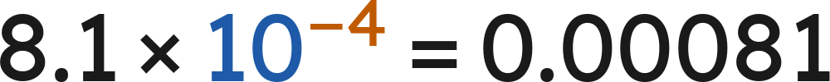
Whiteboards · Question 5 of 9
Which is 0.00081 written in scientific notation?
Move the point 4 places right: 8.1
Answer: D — 8.1 × 10⁻⁴
Grade 7 Accelerated · Unit 3 · Lesson 9 — Writing Small Numbers in Scientific Notation
24

Slide 25
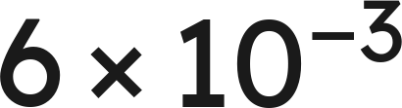
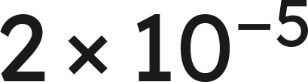
Whiteboards · Question 6 of 9
How many times larger is
than
?
A. 300
B. 30
C. 3
D. 0.03
Answer it.
Grade 7 Accelerated · Unit 3 · Lesson 9 — Writing Small Numbers in Scientific Notation
25

Slide 26
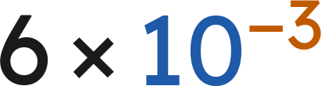
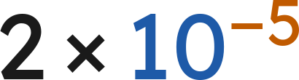


Whiteboards · Question 6 of 9
How many times larger is
than
?
Divide the numbers:
Divide the powers:
Answer: A — 300
Grade 7 Accelerated · Unit 3 · Lesson 9 — Writing Small Numbers in Scientific Notation
26

Slide 27
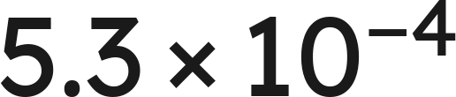
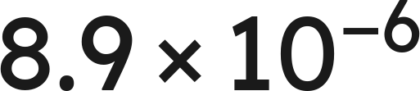
Whiteboards · Question 7 of 9
Which is greater,
or
?
Answer it.
Grade 7 Accelerated · Unit 3 · Lesson 9 — Writing Small Numbers in Scientific Notation
27

Slide 28
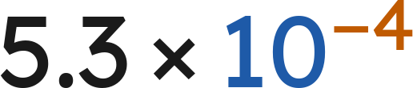
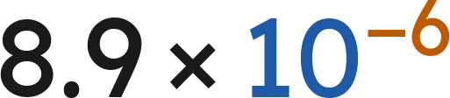
Whiteboards · Question 7 of 9
Which is greater,
or
?
Answer: 5.3 × 10⁻⁴
Grade 7 Accelerated · Unit 3 · Lesson 9 — Writing Small Numbers in Scientific Notation
28

Slide 29
Whiteboards · Question 8 of 9
A computer displays a number as 4.2E−6.
Write the number in standard form.
Answer it.
Grade 7 Accelerated · Unit 3 · Lesson 9 — Writing Small Numbers in Scientific Notation
29

Slide 30

Whiteboards · Question 8 of 9
A computer displays a number as 4.2E−6.
Write the number in standard form.
4.2E−6 means
Answer: 0.0000042
Grade 7 Accelerated · Unit 3 · Lesson 9 — Writing Small Numbers in Scientific Notation
30

Slide 31
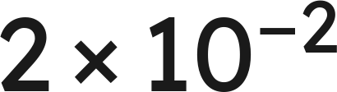
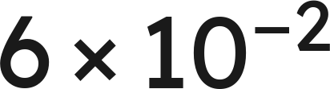
Whiteboards · Question 9 of 9
Fishing line A is
inch thick.
Fishing line B is
inch thick.
Which is thicker, and how many times? Name a thickness between them.
Write your answer in sentences.
Grade 7 Accelerated · Unit 3 · Lesson 9 — Writing Small Numbers in Scientific Notation
31

Slide 32
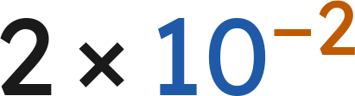
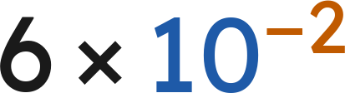

Whiteboards · Question 9 of 9
Fishing line A is
inch thick.
Fishing line B is
inch thick.
Which is thicker, and how many times? Name a thickness between them.
Same power of 10, so compare 2 and 6.
Between them:
Answer: B; 3 times; e.g. 4 × 10⁻² in.
Grade 7 Accelerated · Unit 3 · Lesson 9 — Writing Small Numbers in Scientific Notation
32

Slide 33





Independent Set
1.
Write 0.00047 in scientific notation.
2.
Write
in standard form.
3.
Write 0.0000061 in scientific notation.
4.
Which is greater,
or
?
5.
How many times larger is
than
?
6.
A computer displays a number as 3.7E−5. Write it in standard form.
Grade 7 Accelerated · Unit 3 · Lesson 9 — Writing Small Numbers in Scientific Notation
33

Slide 34
IXL
1.
Open IXL and start today's skills.
2.
Work on paper where the question needs work. The answer box does not show it.
3.
Every skill listed is required, to a SmartScore of 67. Due at the start of the next class.
Today's skills — all required
Convert between standard and scientific notation: small numbers — 85M
Compare small numbers — KDR
Powers of ten with negative exponents — SKD
Grade 7 Accelerated · Unit 3 · Lesson 9 — Writing Small Numbers in Scientific Notation
34

